Slide 1

Melbourne Housing Analysis
By: Abhinav Sharma, Jesper Li, Prashanti Kodi & Mervyn Giritharan
[Group 16]

Slide 2
Overview
01
02
03
Problem Statement
Dataset Description
Exploratory Data Analysis
04
05
Models Used
Results & Conclusion

Slide 3

Problem Statement
01

Slide 4


Melbourne Property Market Rise
Since 2000, real estate prices in Australia have increased by 150%. However, contrary to popular belief, the prices have only skyrocketed since and are expected to rise even more in the future. With such high prices, it has become a topic of discussion on what the ideal places are to invest in real-estate, particularly within Melbourne.
We have been hired by JAMP Realty, a fast growing real estate startup, as real estate analysts. As analysts, we have been tasked with understanding the flourishing Melbourne housing market and its growth to help identify the key locations to invest in and build around the city.
Notes:
Given the rise in house pricing at an alarming rate, some economists have theorized that the Australian property market would finally collapse.

Slide 5

Some Questions We Want to Answer
We set out to conduct our analysis and answer 2 important questions:
How much have property prices increased in recent years?
What are the best areas for investment in Melbourne?

Slide 6

Dataset Description
02

Slide 7

Source
Elements
The Kaggle dataset contains data which was scraped from publicly available results posted every week from Domain.com.au. It has already been cleaned which makes it easier for us to work our data analysis magic.
The dataset includes important information of each property such as Region Name, Number of Rooms, Price, Type of Real estate, Suburb in which it is located, Method of selling, Name of the Real Estate Agent, Date of Sale and Distance from C.B.D(Melbourne City Center).

Slide 8
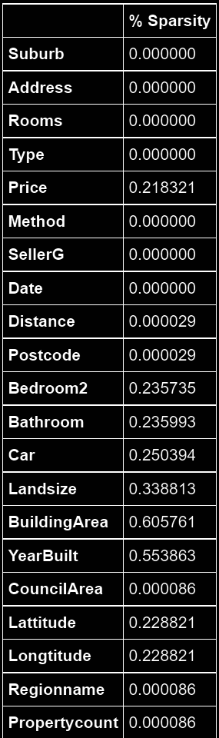

Data Wrangling
Original Dataset
Cleaned Dataset
Removed columns with more than 50% null values.
Removed rows which had null value in Price.
Filled missing values with mean for continuous variables and mode in for categorical variables.
34857 observations
21 variables
27247 observations
16 variables

Slide 9
Numerical Variables v/s Categorical Variables
Variable | Description
Rooms | Number of rooms
Price | Price in Australian dollars
Distance | Distance from CBD in kilometres
Propertycount | # of properties that exist in the suburb
Bedroom | Number of bedrooms
Bathroom | Number of bathrooms
Car | Number of car parking spots
Landsize | Land size in meters
Latitude & Longitude | Latitude & Longitude of the property
Week and Year | Week of the year and year of sale
Variable | Description
Councilarea | Name of the Council
Method | Method in which house was sold
Type | Types of the property
Regionname | General region
SellerG | Real estate agent
Month | Month of the Sale

Slide 10

Exploratory Data
Analysis
03

Slide 11
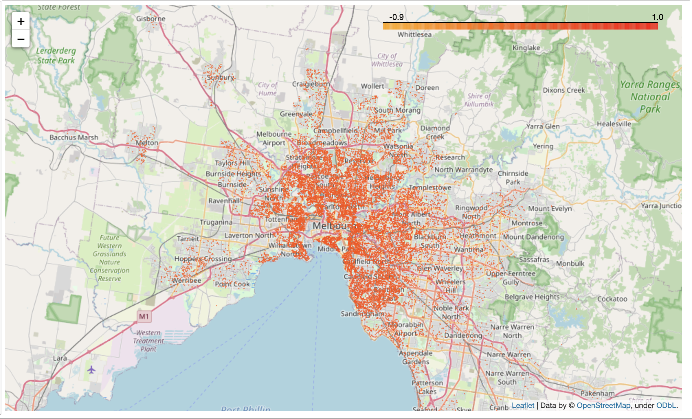
Housing in Melbourne
Using latitude and longitude, we plot all our properties on Melbourne map to get a visual sense of the market we’re about to analyze

Slide 12
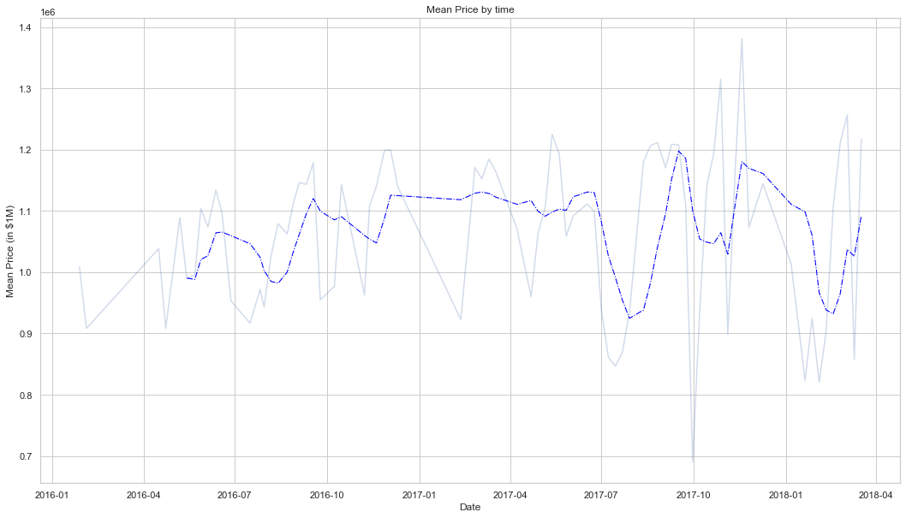
Time Series Graph (Mean Price by Time)
Before doing exploratory data analysis, we decided to create a graph of price based on a time series from 2016 to 2018.
With rolling window of 6 periods, trend (dashed blue) looks seemingly stable with slight fluctuations in mid-2017
Mean Price v/s Date

Slide 13
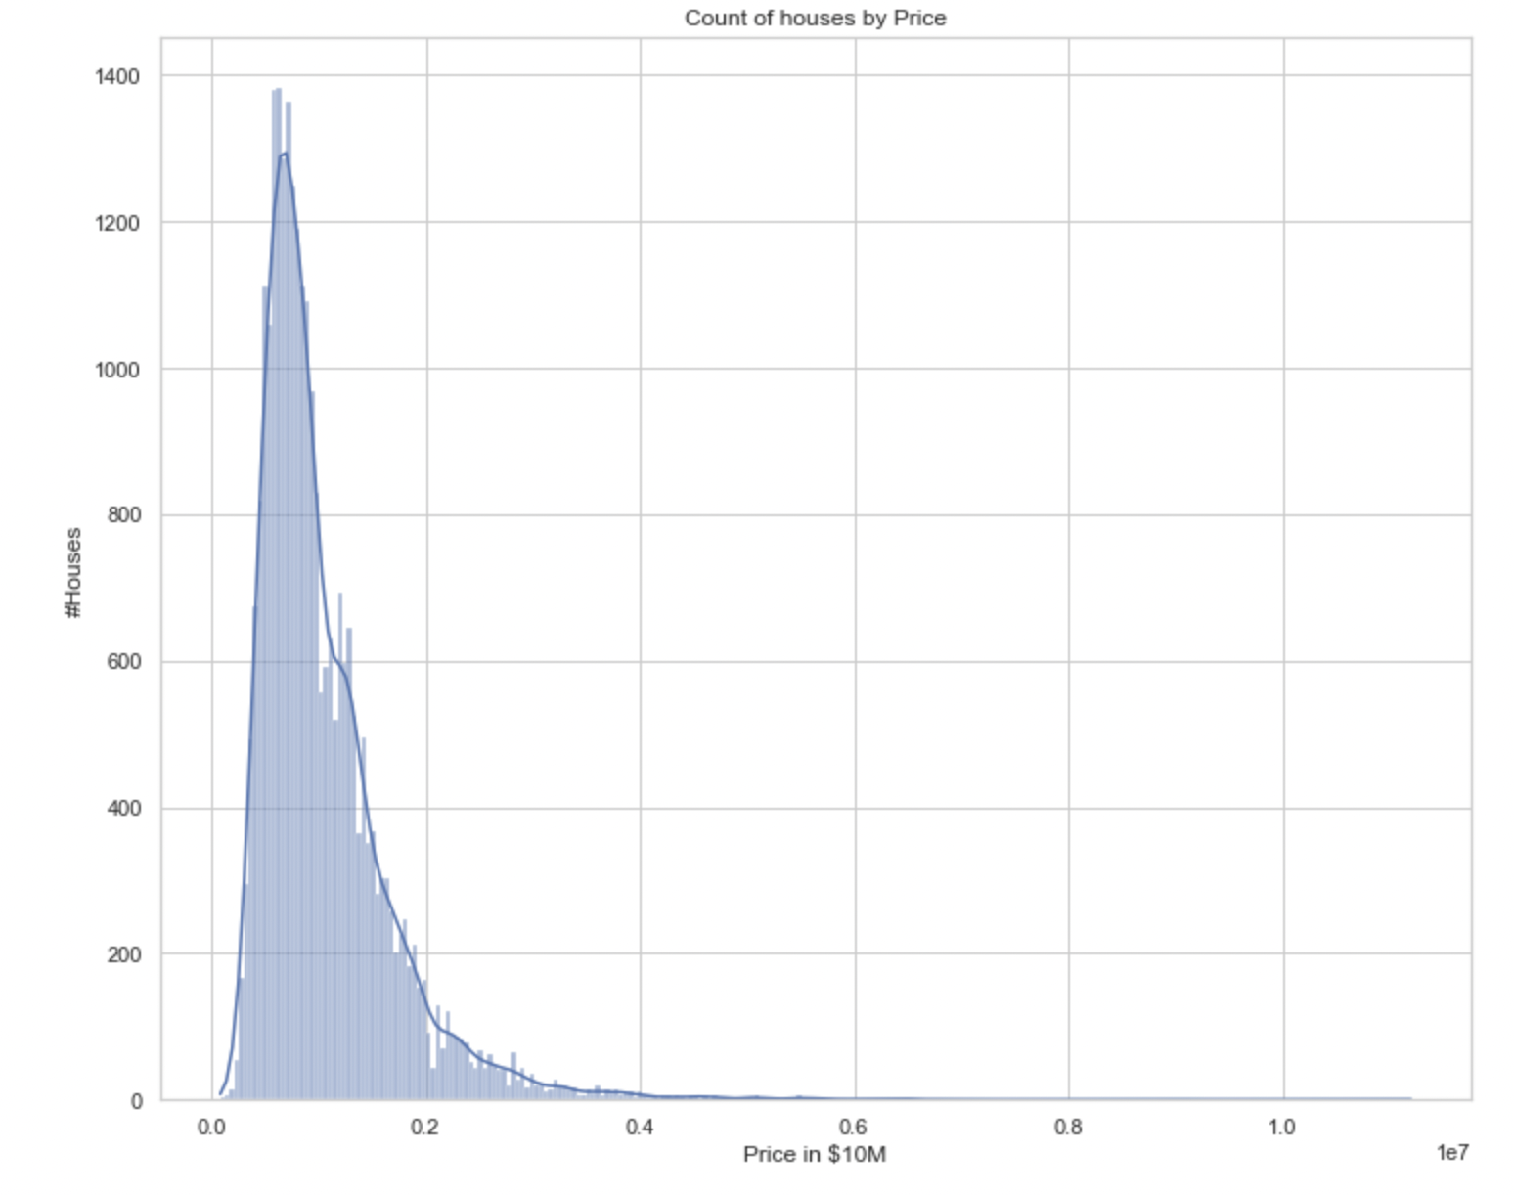
Price histogram
From the graph, we see the distribution of prices is very right skewed
Models may find it difficult to predict high priced properties

Slide 14
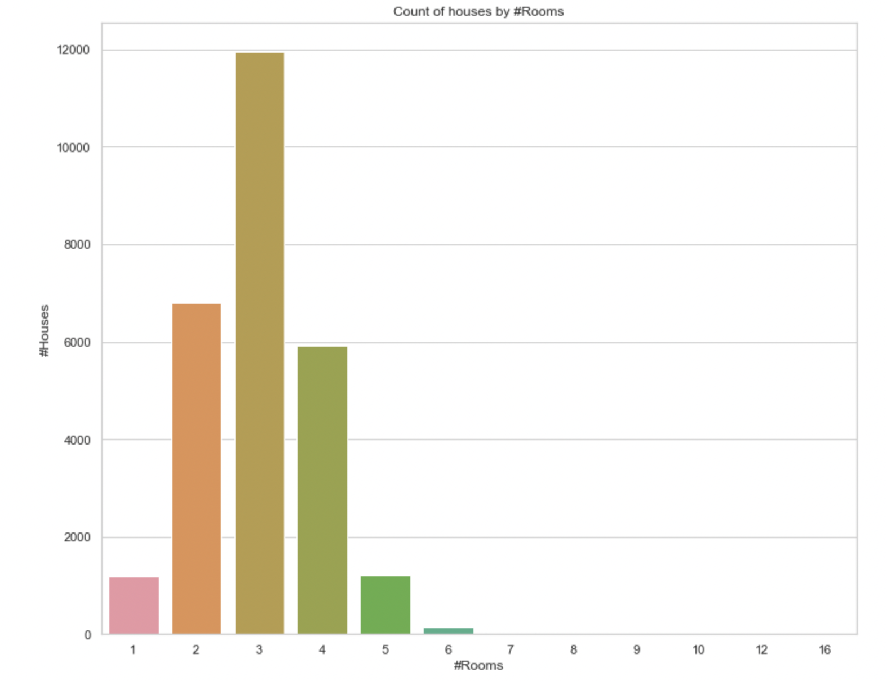
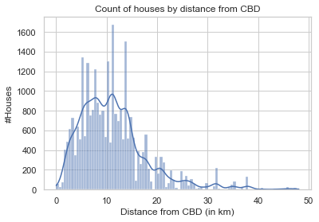
Univariate EDA
From the graph, we see most properties have 2-4 rooms and are located within 5-15 kilometers from the Melbourne City Business District

Slide 15
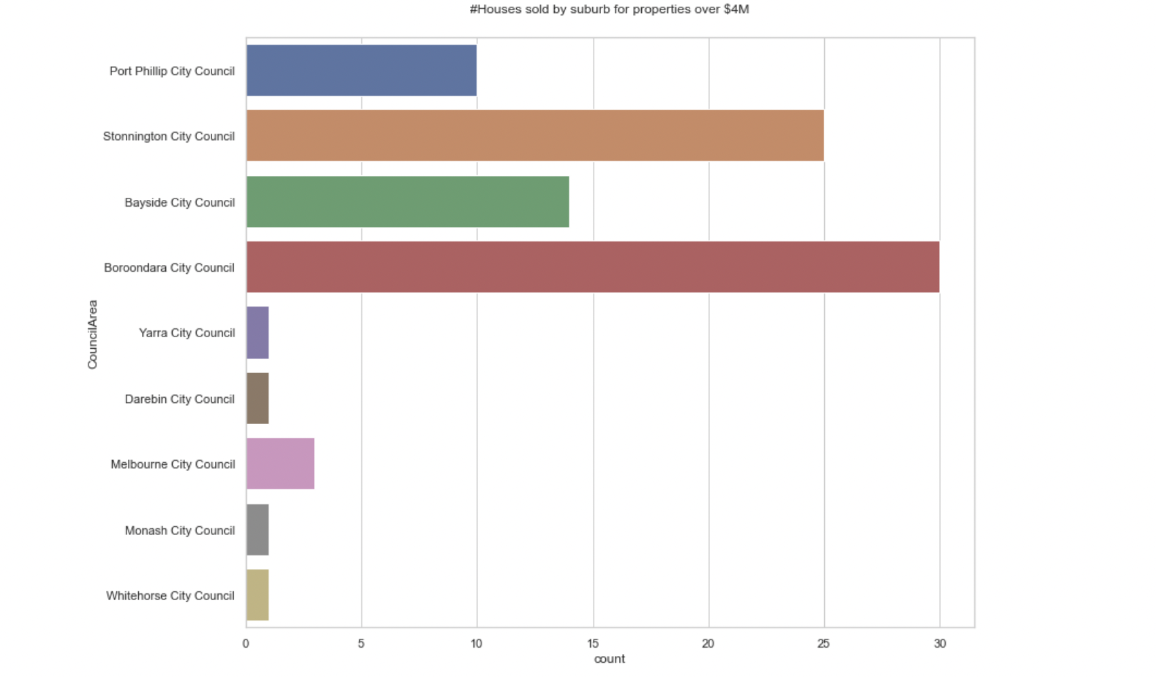
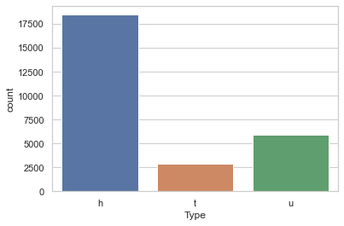
Univariate EDA
CouncilAreas with high-priced properties
Counts of the types of houses
More houses than units or townhouses. Council areas of Stonnington, Bayside City and Boroondara City have more high priced listings

Slide 16
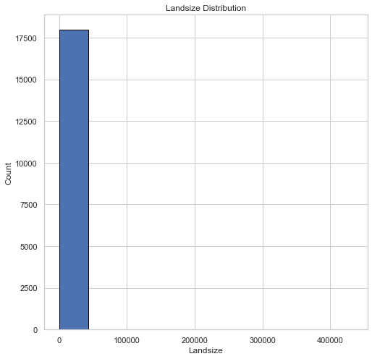
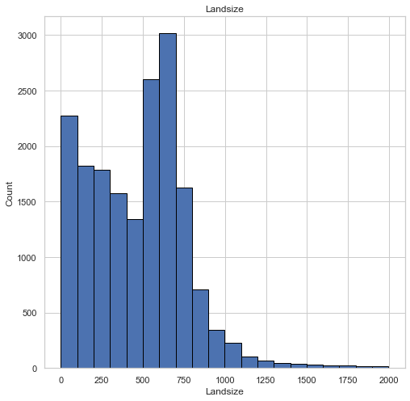
Outlier treatment
Landsize distribution prior to outlier removal
Landsize distribution after outlier removal
Outliers are data points with price below the first quartile minus 3 times of interquartile range or above the third quartile plus 3 times of the interquartile range.

Slide 17
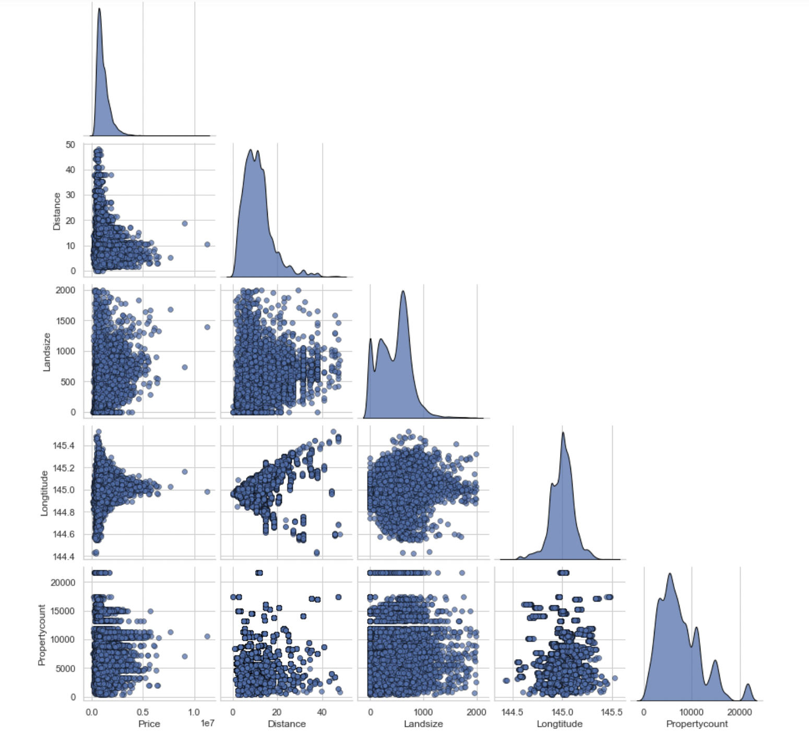
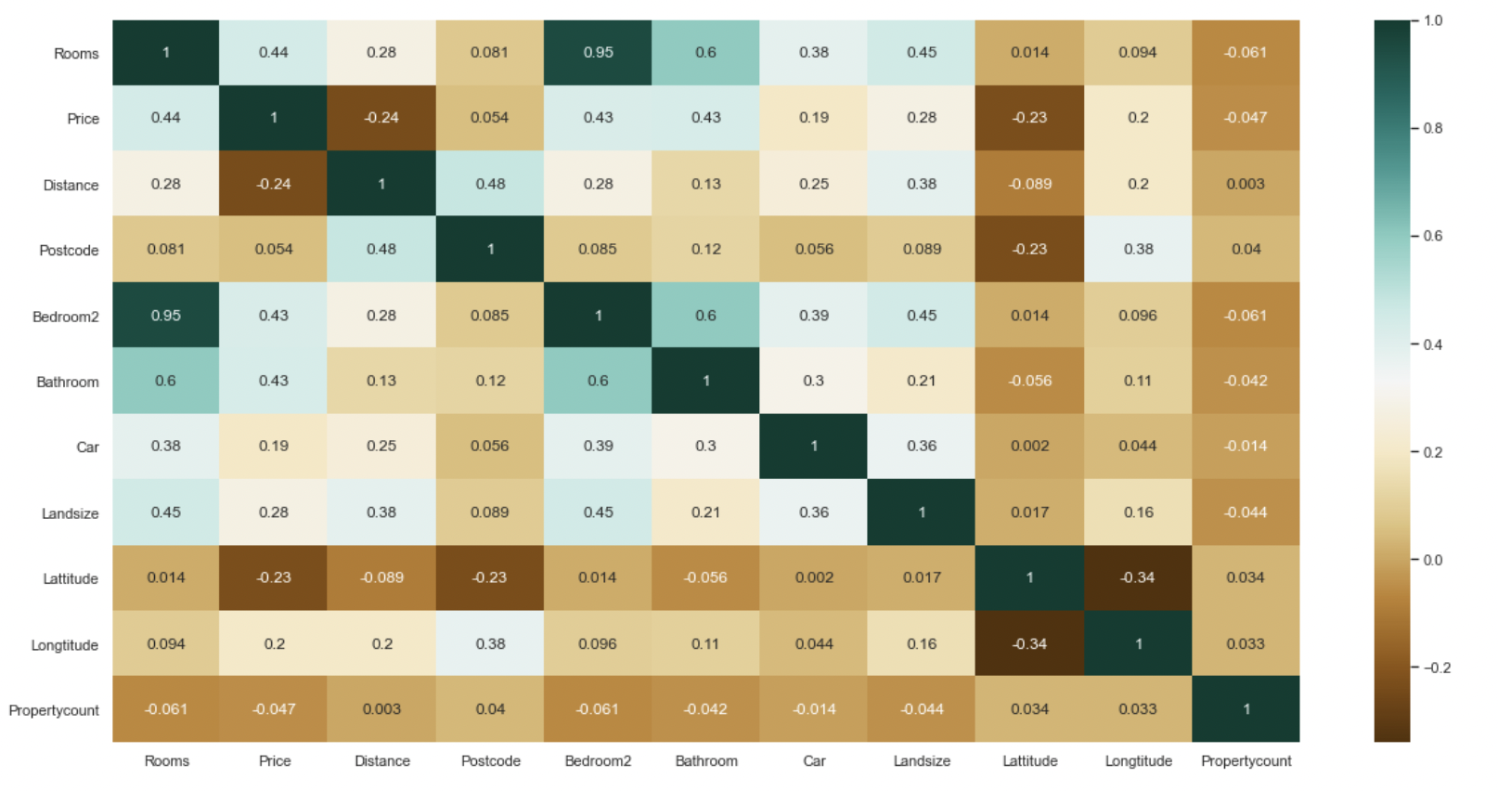
Bivariate Distributions
We observe significant correlation of property price with respect to number of rooms, Distance from CBD, land size and latitude.
We can now observe bivariate relationship for variables most correlated with Price.

Slide 18
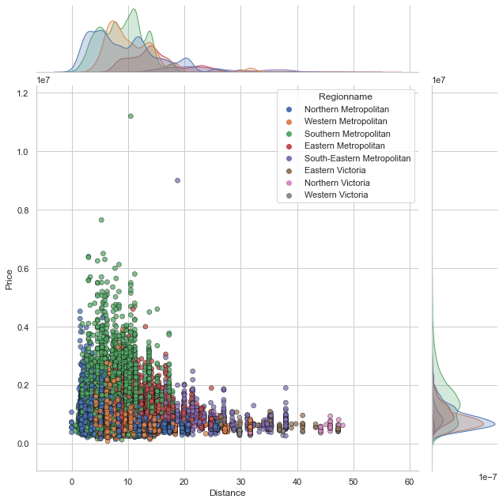
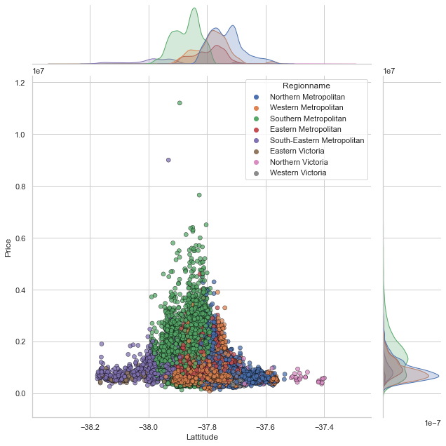
Bivariate association with Price
We see high prices associated with Metropolitan areas in general, particularly properties bounded by latitudes -38 to -37.7

Slide 19
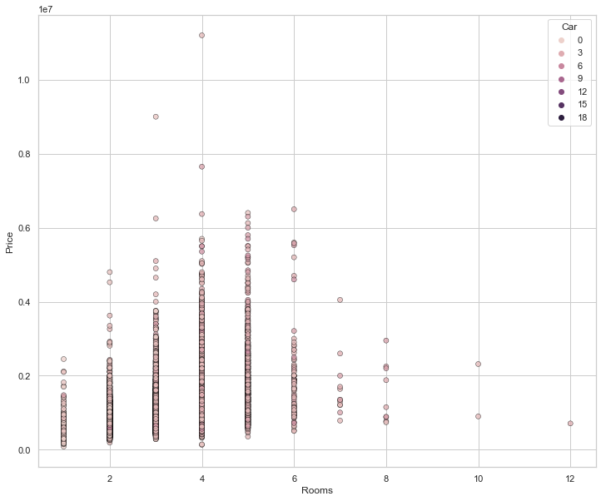
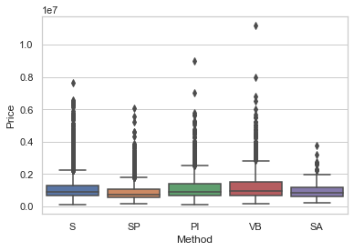
Interestingly, best price is associated with property having number of rooms 4-6. Number of carspots hardly has any effect.
Methods of selling such as direct sale, property passed in and vendor bid have relatively higher price.

Slide 20

Models Used
04

Slide 21
Overview of Models Used
Model Name | Hyperparameters | Test set R-square
Decision Tree | Max depth = 15 | 0.5622
Pruned Tree | Max depth = 10, Complexity parameter = 0.009 | 0.6385
KNN Regressor | k = 10 | 0.7066
KNN Regressor | k = 15 | 0.7071
Randomforest | #trees = 800, ccp alpha = 0.001, max depth = 40 | 0.7881
Randomforest | #trees = 800, ccp alpha = 0.001, max depth = 15 | 0.7882
Randomforest | #trees = 800, ccp alpha = 0.001, max depth = 10 | 0.7722
XGBoost | #trees = 800 | 0.789
LightGBM | #trees = 800, ccp alpha = 0.001, max depth = 40 | 0.8082
LightGBM | #trees = 800, colsample = 0.4 | 0.8117
LightGBM | #trees = 800, min child weight = 50 | 0.8067
Support Vector Regression | C = 0.1 | -0.0877

Slide 22
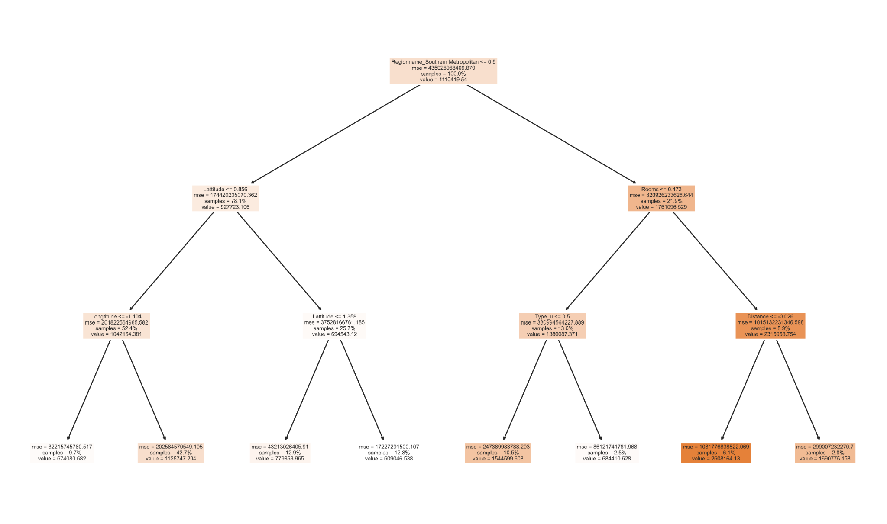
Decision Trees
Since tree models were performing better, we were curious as to how a sample tree looked and which features were used for the first few cuts
Here we can observe that the first few cuts are made on Region name, Latitude, Number of Rooms, type of house and Distance from CBD

Slide 23
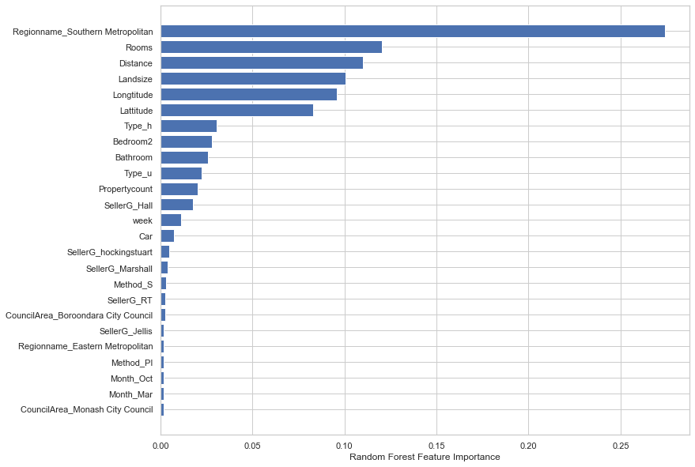
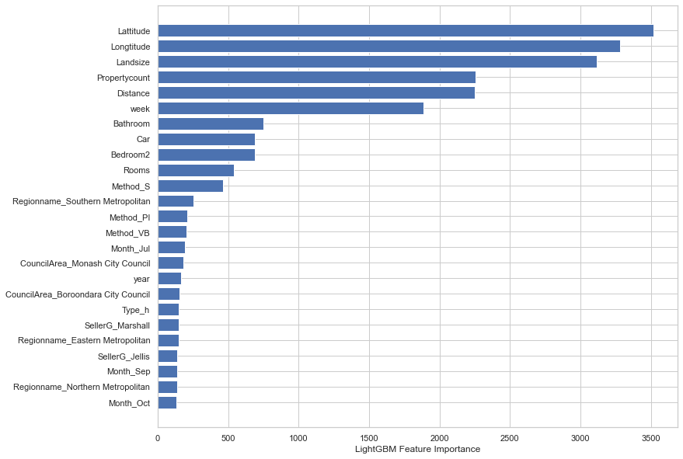
Variable Importance
Here, we observed different models pointed towards similar top variables.
Model explainability on refitted models with Top 50 variables from original model feature importance to reduce dimensionality, especially for SHAP

Slide 24
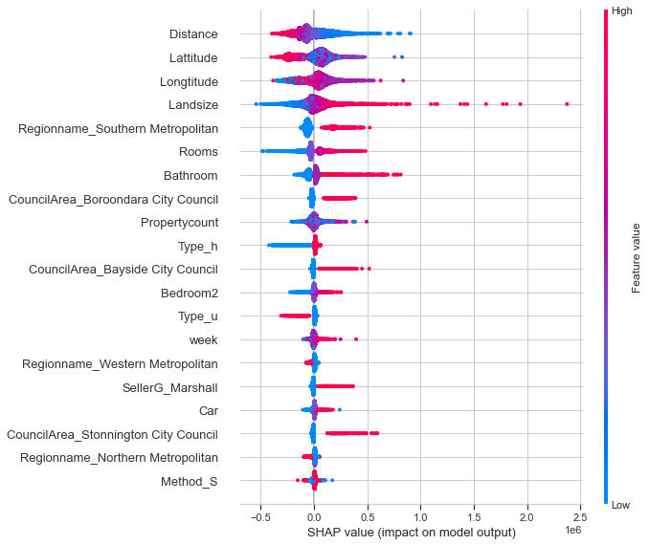
Shap Values
Higher prices associated with houses with decreasing distance from CBD, latitude
Higher prices associated with increasing longitude, landsize and number of rooms
Higher prices towards year end in Southern Metropolitan region, preferably under council areas of either Bayside, Boroondara or Stonnington

Slide 25

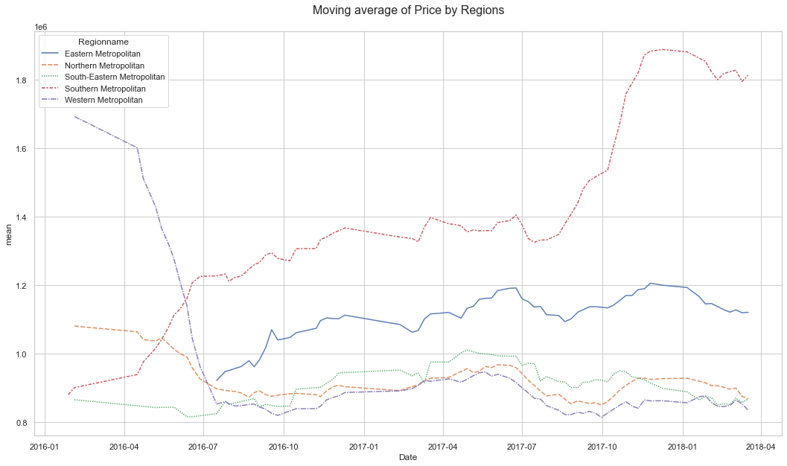
Solution
Given model identifies regionname as one of the top segregators of price differences, trends by region reflect diverging markets. While most regions are cooling off or stable, southern metropolitan is booming.

Slide 26

Results & Conclusion
05

Slide 27
Region
Seasonality
Our Suggestion
The market for regions other than the Southern Metropolitan are cooling off.
For people wanting to invest in Melbourne, they should invest in the Southern area.
Surprisingly, there isn’t a lot of seasonality in our time series.
We do see the week variable suggesting there is some increasing trend in prices during the course of an year.
Our final recommendation would be to invest in a house in the Southern Metropolitan region, if possible, under Boroondara or Bayside City council with decent to high number of Rooms, bathrooms etc. ideally at the start of year.
For best returns, the preferred real estate agent while selling the house is Marshall.

Slide 28




Thanks
Does anyone have any questions?

